Slide 1



PayVengers
Hackathon 2025

Slide 2
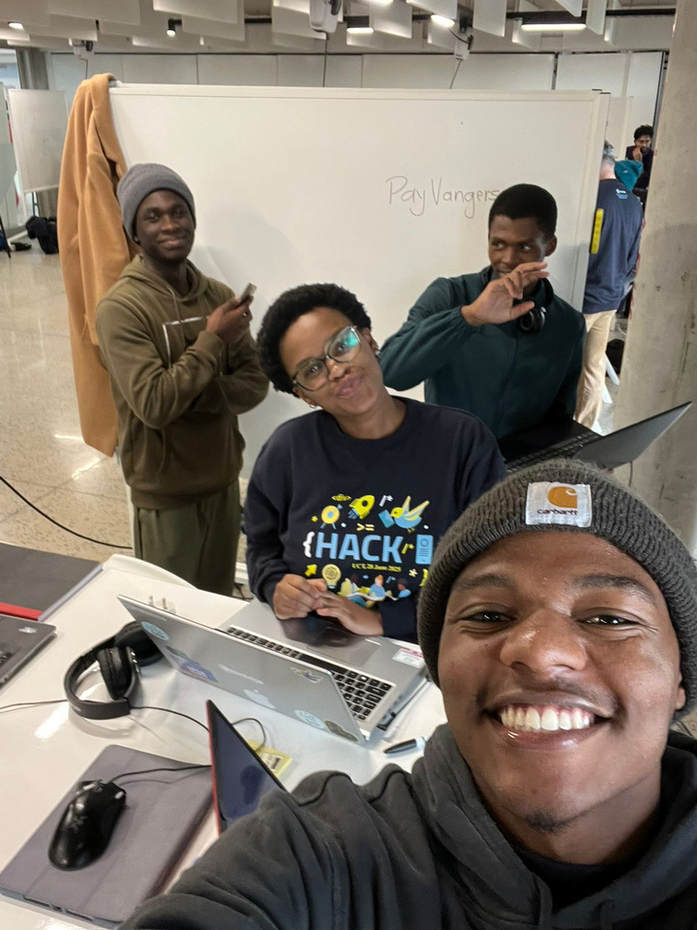

Meet the team
PayVengers
Morris Nkomo
Michelle Muthelo
Samkelo Mlotshwa
Wisdom Ndeh
Libhongo Langa
#ILPhacks
@interledger #openpayments

Slide 3
Problem statement
Many freelance platforms struggle with payment disputes, delayed releases, and lack of trust between clients and freelancers. Traditional freelance platforms rely on slow, opaque payment systems with high fees, manual approvals, and centralized control over funds.
This creates:
- Payment delays (manual holds, slow processing).
- Unnecessary disputes due to lack of trust.
- High fees from intermediaries (banks, payment processors).
- Limited transparency, freelancers and clients can’t track funds in real time.
#ILPhacks
@interledger #openpayments

Slide 4
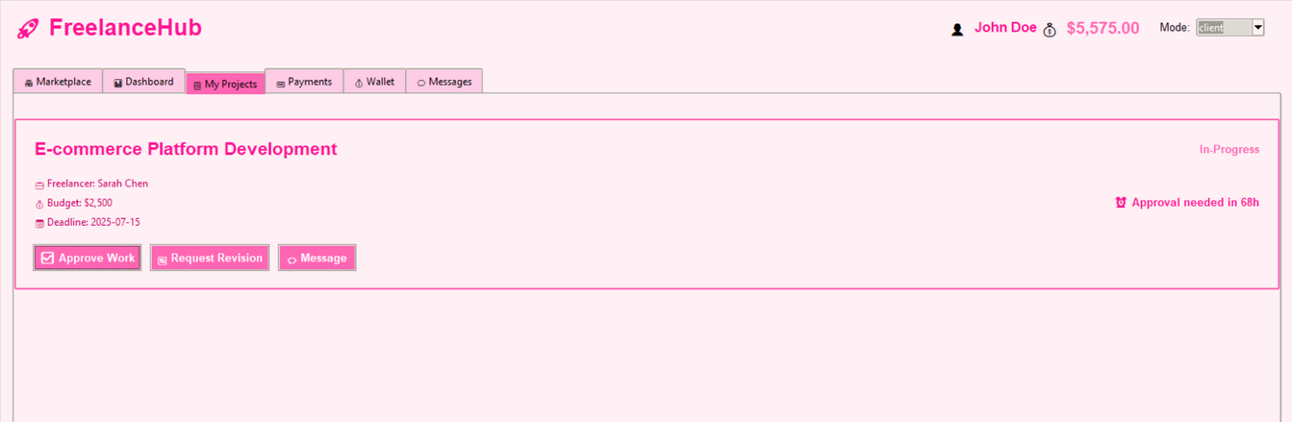
1 in 4 Freelancers Face Late Payments
25% of freelancers report late payments, hurting cash flow and trust (Source: [Upwork 2023 Report]).
37% of companies rely on global freelancers but struggle with cross-border fees/delays (Source: [Payoneer 2024 Survey]).
Result:
Wasted time on disputes, high fees (5–10%), and opaque escrow systems.
#ILPhacks
@interledger #openpayments

Slide 5
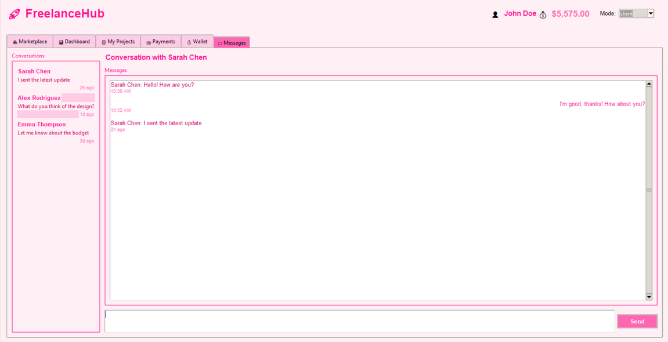
The Trust Gap in Freelancing
Cross-border freelancing is growing (37% adoption), but legacy systems aren’t built for it.
$1.2T freelance economy loses billions annually to fees and delays.
82% of freelancers say payment security is their top concern (Source: PayPal 2023).
63% of disputes arise from unclear payment terms (Source: Freelancers Union).
Why It Matters:
Open Payments’ on-chain transparency addresses both.
#ILPhacks
@interledger #openpayments
Notes:
Speaker Notes:
Emphasize the human impact: "Late payments aren’t just numbers—they mean rent delays, missed opportunities, and broken trust."
Link to solution: "Our smart escrow ensures freelancers get paid daily for hourly work and instantly on approval lump work, solving the 25% problem."

Slide 6
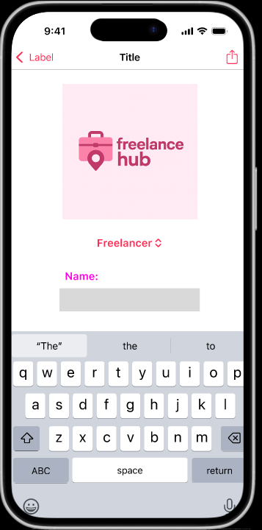
Solution
A blockchain-based escrow system using Open Payments (OP) that automates freelance payments with smart contracts, eliminating delays and disputes.
Key Components:
Smart Escrow - Funds locked in a transparent hot wallet.
Auto-Release Triggers - Time-based (72hr) or instant approval.
On-Chain Evidence - Immutable work logs for disputes.
Self-Custody - Freelancers withdraw to any OP-compatible wallet.
#ILPhacks
@interledger #openpayments

Slide 7
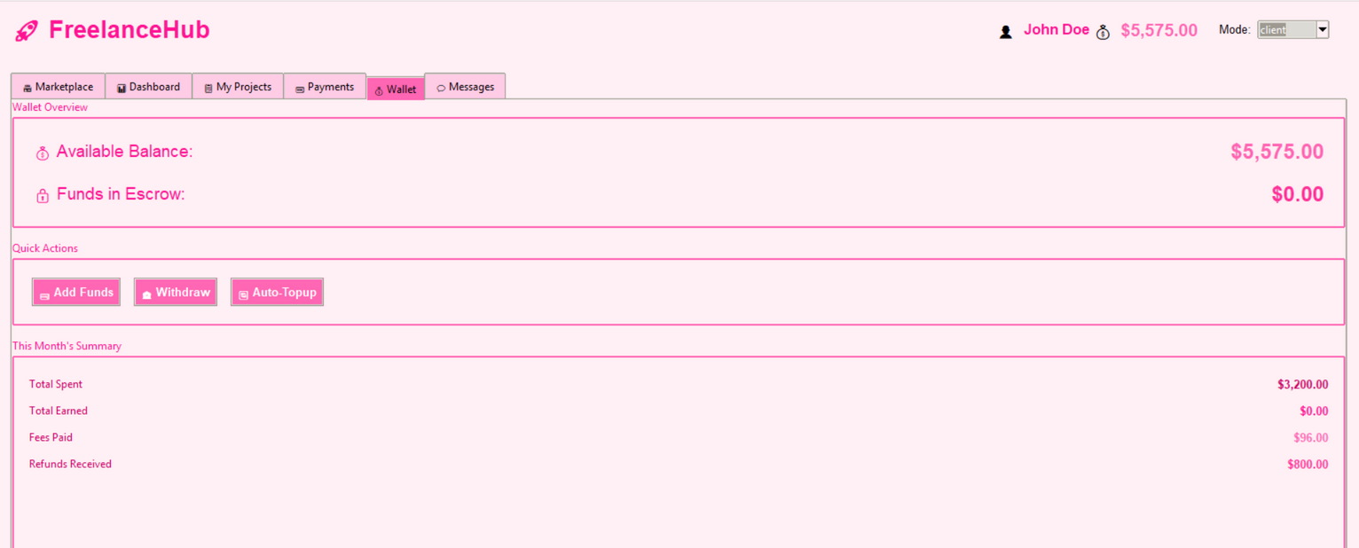
Tools & Tech Stack
Blockchain: Open Payments (OP) for instant settlements.
Frontend: React.js + WalletConnect for user-friendly UI.
Backend: Node.js to track off-chain data (e.g., work submissions).
#ILPhacks
@interledger #openpayments

Slide 8
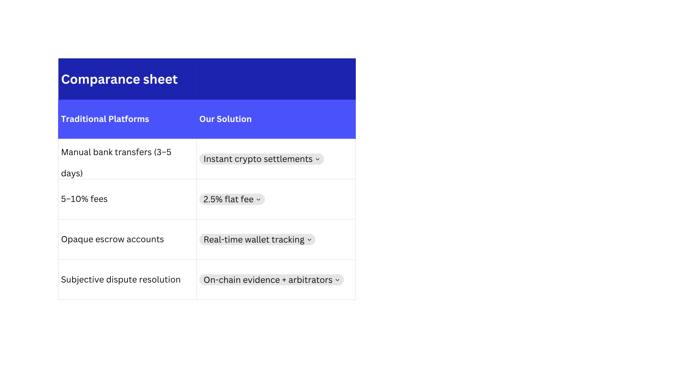
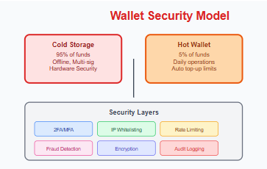
Why We’re Unique
#ILPhacks
@interledger #openpayments

Slide 9
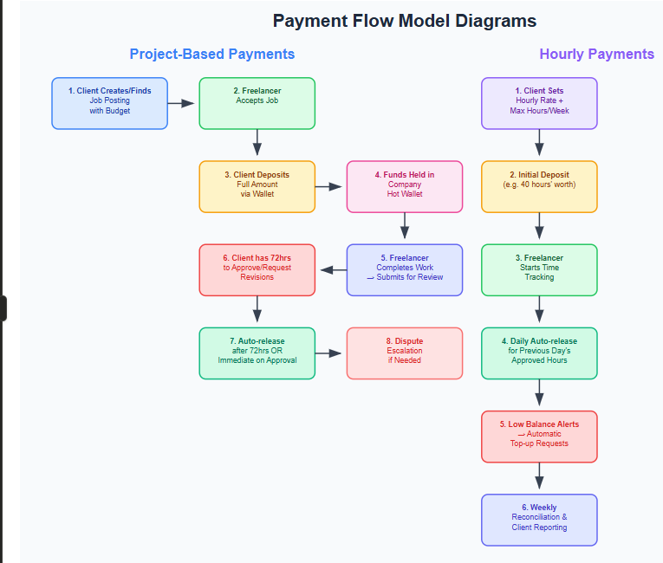


Solution

Slide 10
Demo
recorded
#ILPhacks
@interledger #openpayments

Slide 11
Conclusion
Summary:
Project-Based Payments – Escrow-style system with 72-hour approval window and auto-release.
Hourly Payments – Daily auto-payouts for tracked hours with balance alerts and weekly reconciliation.
Dispute Resolution – 3-day auto-approval, optional arbitration, and reputation-based escrow terms.
Fees – 2.5% platform fee (shared), client covers deposit fees, freelancer pays withdrawal fees.
Risk Management – Reputation-based limits to mitigate fraud.
Next Steps
AI-Powered Escrow & Dispute Avoidance
Use AI to analyze freelancer submission quality (e.g., file completeness, git commits, Figma version history) and auto-flag "high-risk" deliveries for client attention.
Predictive Dispute Alerts: ML model detects tension in chat logs (e.g., frustrated tone, delayed responses) and proactively suggests mediation.
#ILPhacks
@interledger #openpayments

